Slide 1
Field Methods 2
When a GPS only won’t do:
  Forestry canopies
  Canyons (no reception or can’t reach)
  Underwater
  Small areas when you don’t have a sub-meter GPS
  You can see but can’t get to the features
    Bottom of a canyon
    Across a stream
    Part way up a clif

Slide 2
Definitions
Bearing – direction to target (a.k.a. azimuth)
  Typically measured with a compass
Heading – direction of travel
  Note: A GPS provides a heading while you’re moving by finding the angle between your current location and a previous one. Because of this, it’s accuracy is poor and unreliable.

Slide 3
Basic Idea
Establish a “station” (a.k.a. benchmark) with more than adequate certainty
“Shoot” “meets and bounds” to points
  Measure direction and distance
Convert to coordinates
Must use a projected system!
  E.g. UTM, State Plane
Accuracy decreases as you move from point to point.
Notes:
In the forest, a general rule is that you will be off by 10% (i.e. if you go 1000 meters, you’ll be off by 100meters!).

Slide 4

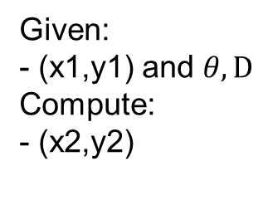
A little trig…
New Coordinate
(x2,y2)
North
dx
dy
D
Given:
- (x1,y1) and $θ, D$
Compute:
- (x2,y2)
$$θ$$
Existing Coordinate
(x1,y1)
Note: This only works in projected systems and there will always be error
Notes:
SOHCAHTOA
Sin(theta)=dx/D
Cos(theta)=dy/D

Slide 5
Compasses
The earth has a magnetic field that has a “north pole” and a “south pole” just like typical magnets
We can use this field and something that is magnetized to orient ourselves just about anywhere on the earth.

Slide 6
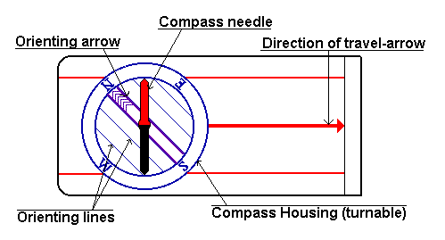
Field Compass
How to use a compass

Slide 7
Finding Direction
Point the “Direction of Travel-Arrow” in the direction you want to go
Turn the compass housing to make the north arrow (red part of the compass needle) line up with the orienting needle.
Check the direction of travel arrow again
Record the angle that is next to the direction of travel arrow
Add the appropriate amount of declination

Slide 8
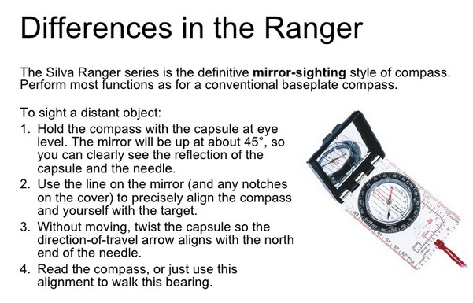
Mirror-sighting Compass
Wilderness Learning Center

Slide 9
Declination
“North” is not magnetic north
Compasses measure magnetic north (approximately)
See: Wiki page at:
  https://en.wikipedia.org/wiki/Magnetic_declination
  Check out the cool animation on how declination has changed
Find out declination at:
  http://www.ngdc.noaa.gov/geomag-web/

Slide 10
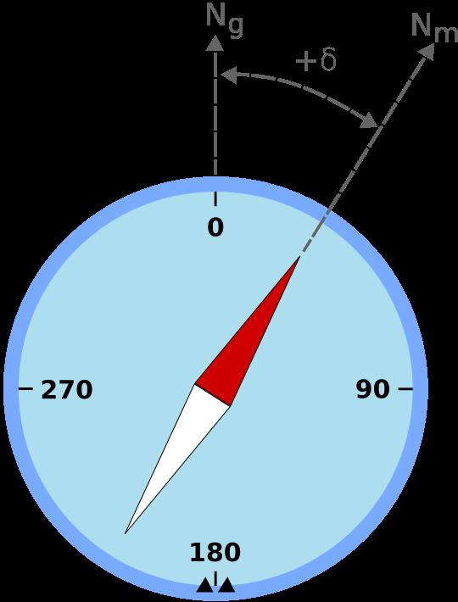
Declination
If we measure 0 degrees on a compass, the actually point is off by the “declination”.
We must add the declination to all our angles
Try it and check on a map

Slide 11
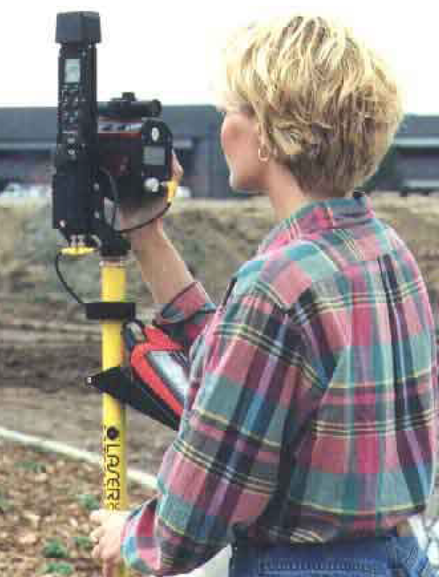
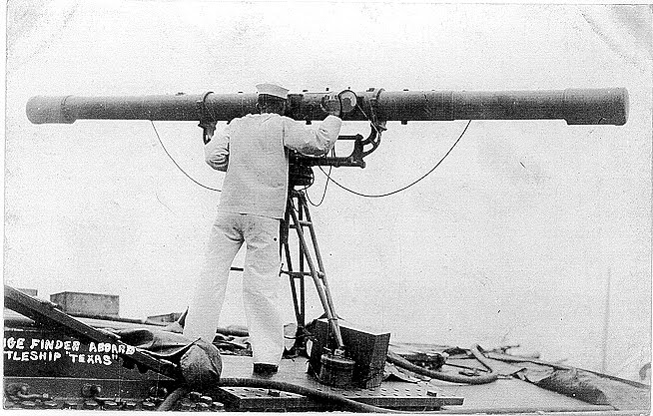
Measuring Distance
Best:
  Laser distance measuring tool
Next best:
  A lightweight measuring tape
Worst:
  Pacing

Slide 12
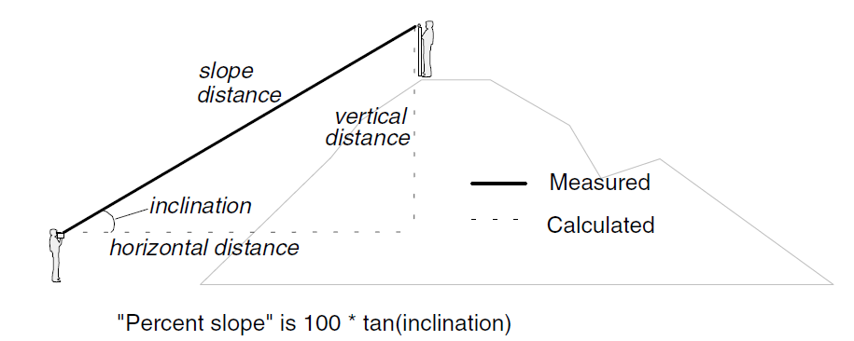
Distance with a Range Finder
The range finder will calculate the horizontal and vertical distance for you.

Slide 13
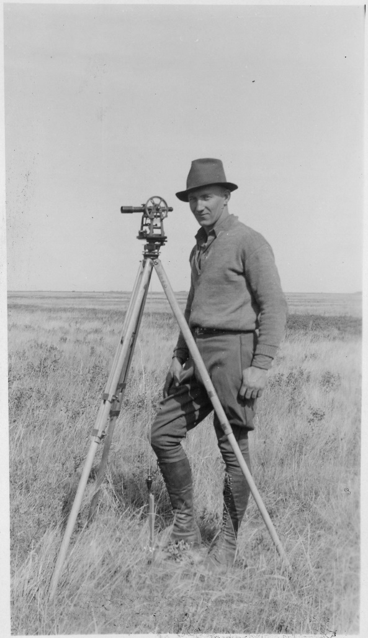
Leveling Rod
Without a leveling rod, inclinations and horizontal distances will be incorrect
Can also adjust later

Slide 14
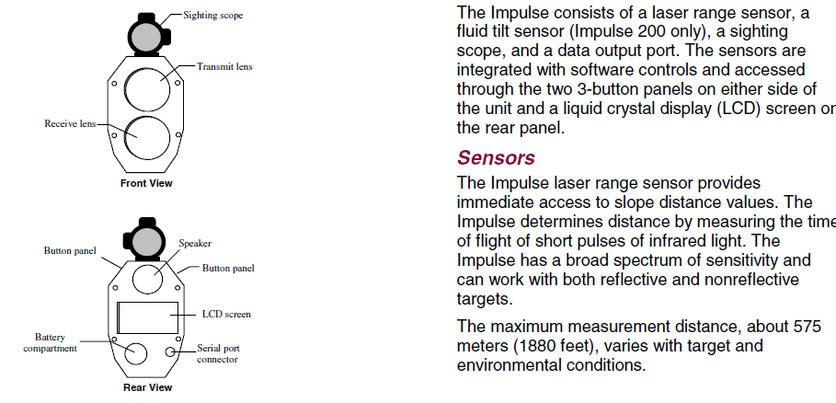
Laser Range Finder
From Laser Tech’s user’s manual

Slide 15
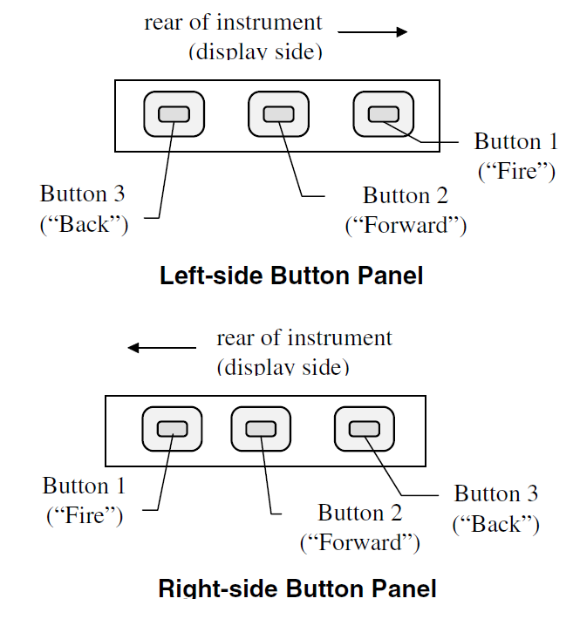
Taking a Horizontal Distance
Press the “Fire” button to turn on the range finder
The display panel should show “HD” for “Horizontal Distance”.
If not, press “Forward” until you see “HD”.
Laser Tech Inc.

Slide 16
Taking a Horizontal Distance
Point the range finder at a target.
Press “Fire” to turn on the laser pointer.
Press and hold “Fire” until you hear a beep
Release “Fire” you should see a distance.
Record the distance including the units “F” for feet, “M” for meters
Take another measurement by pressing “Fire”.
When done, press “Forward” and “Back” at the same time to turn off the range finder.

Slide 17
Taking a Horizontal Distance
If the display shows “EO 1”, you did not get a good signal back from the target.
Try again or use the reflector on a pole.
See the user’s manual for more information.

Slide 18
Taking other Measurements
Turn on the range finder.
Use forward until “INC” is displayed
  Press “Fire” and record the inclination value
Use forward until “HT” is displayed
  Press “Fire and record the height value

Slide 19
Additional Resources
1-page guide from SFSU

Slide 20
Additional Slides

Slide 21
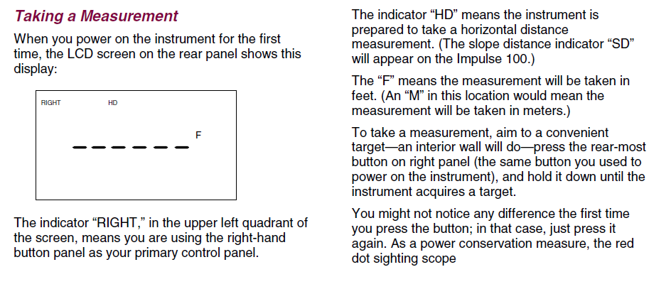
Note: the range finder appears to only take measurements if the target is very white or you used the included target.

Slide 22
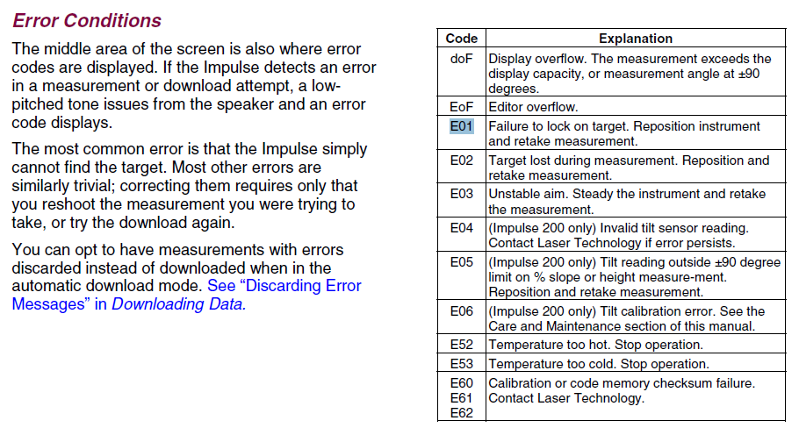

Slide 23
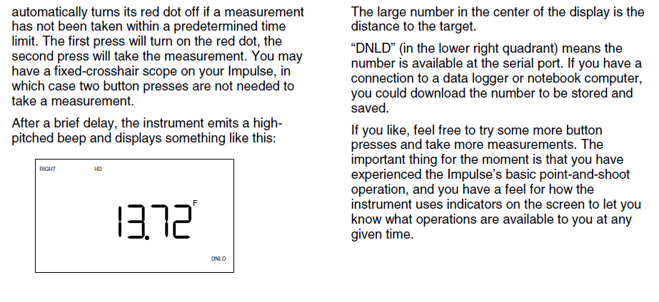

Slide 24
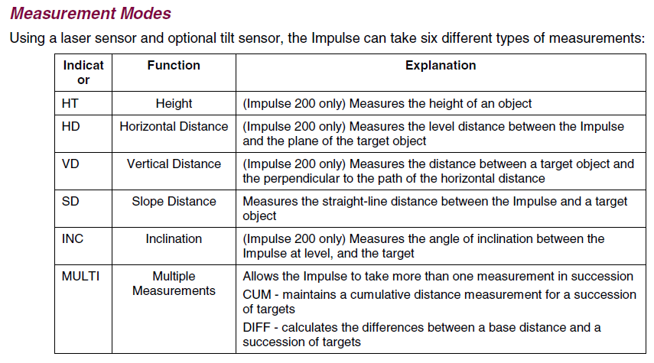

Slide 25
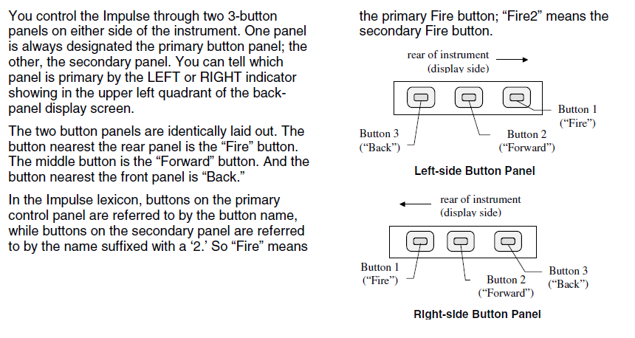

Slide 26
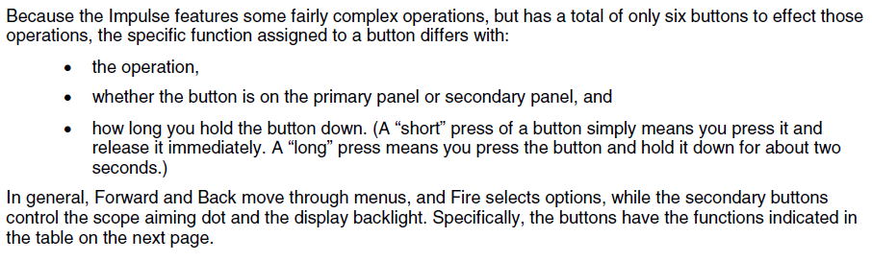

Slide 27
